Slide 1

Shareholder Rights and Corporate Governance
Chapter 13
©2020 McGraw-Hill Education. All rights reserved. Authorized only for instructor use in the classroom. No reproduction or further distribution permitted without the prior written consent of McGraw-Hill Education.

Slide 2
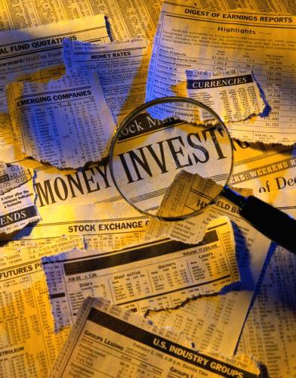
Who Are Shareholders?
Shareholders: The legal owners of business corporations (also called stockholders or investors).
Types of shareholders:
  Individual shareholders
  Institutions
Notes:
Shareholders: The legal owners of business corporations (also called stockholders or investors).
Types of shareholders:
Individual shareholders are people who directly own shares of stock issued by companies.
Institutions (also called institutional investors).
Examples: pension funds, mutual funds, insurance companies, and university endowments.
Shareholder Trends:
In 2016, institutions accounted for about 60 percent of the value of all U.S. stocks, worth $23 trillion.
In 2017, slightly over half of all U.S. households owned stocks
Either directly or indirectly through holdings in mutual funds.
Twice as many older working-age adults (50-64) own stocks than young adults under 30.
Equity ownership is higher as income and education rises.

Slide 3
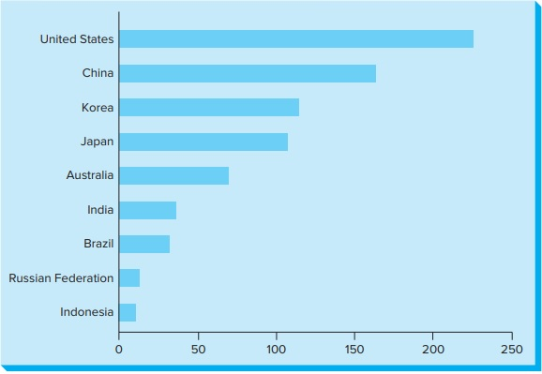
Stock Market Capitalization as a Percentage of GDP, 2016
Copyright © McGraw-Hill Education. Permission required for reproduction or display.
Figure 13.1
Access the text alternative for these images.
Notes:
USA has a very high market capitalization
Canada is at 115% currently, 2018 it was 143% and in 1999 it was 214%.
These numbers range up and down and there is a discussion as to what the ideal number is (not the higher the better)

Slide 4
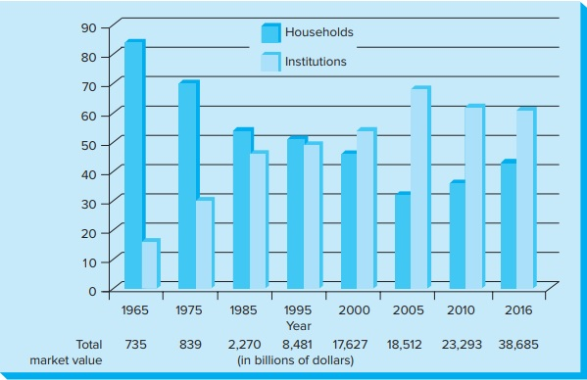
Household Versus Institutional Ownership in the United States
Copyright © McGraw-Hill Education. Permission required for reproduction or display.
Figure 13.2
Access the text alternative for these images.

Slide 5
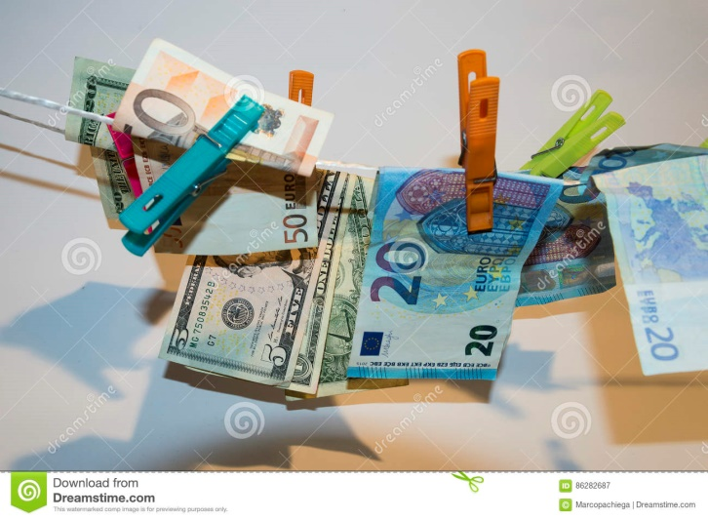
Objectives of Stock Ownership1
To produce a greater return over the long run than other investments, such as bonds or cash.
Shareholders are not a uniform group
Some investors use stock ownership to achieve social or ethical objectives:
Notes:
To produce a greater return over the long run than other investments, such as bonds or cash.
Shareholders make money:
when the price of the stock rises (capital appreciation).
when they receive their share of the company’s earnings (capital dividends).
Bull markets alternate with bear markets.

Slide 6
Major Legal Rights of Shareholders
From Figure 13.3
Copyright © McGraw-Hill Education. Permission required for reproduction or display.
1. To receive dividends, if declared.
2. To vote on: Members of board of directors. Major mergers and acquisitions. Charter and bylaw changes. Proposals by stockholders.
3. To receive annual reports on the company’s financial condition.
4. To bring shareholder suits against the company and officers.
5. To sell their own shares of stock to others.

Slide 7

Corporate Governance
Corporate governance
Board of directors
Notes:
Corporate governance
Refers to the process by which a company is controlled, or governed.
Board of directors
An elected group of individuals who have a legal duty to establish corporate objectives, develop broad policies, and select top-level personnel to carry out these objectives and policies.

Slide 8

Corporate Governance
Board of Directors
Principles of Good Governance
Improving Corporate Governance Worldwide
Notes:
Board of Directors
Vary in size, composition, and structure to best serve the interests of the corporation and shareholders.
Survey of governance practices in leading firms in the Americas, Europe, and Asia Pacific:
Typical board size is between 9 and 11 members.
Most are outside directors (not managers of the company, who are known as inside directors).
Board members are elected by shareholders at the annual meeting, where absent owners vote by proxy.
Process is not truly democratic; board membership tends to be self-perpetuating.
The board nominating committee, working with the CEO and chairman, develops a list of candidates.
After final selection, the names of these individuals are placed on the proxy ballot.
Alternative candidates are rarely presented.
Principles of Good Governance
Principles:
Select outside directors to fill most positions.
Hold open elections for members of the board.
Hold elections for all directors annually.
Appoint an independent lead director.
Diversify board membership.
Improving Corporate Governance Worldwide
OECD, representing 34 nations, issued a set of principles of corporate governance to serve as a benchmark for companies and policy makers worldwide.
The European Union has worked hard to modernize corporate governance practices and harmonize them across its member states.

Slide 9

Special Issue: Executive Compensation1
Setting executive compensation is a key Board function.
Many critics feel that this system is not working and executive pay has become excessive.
Executive compensation in the United States by international standards, is very high.
Notes:
Setting executive compensation is a key Board function.
The emergence of the modern, publicly held corporation in the late 1800s effectively separated ownership and control.
This development gave rise to the agency problem: as hired agents, managers might act to benefit themselves, rather than owners.
Executive compensation is an important mechanism for aligning the interests of the corporation and its shareholders with those of its top managers.
Many critics feel that this system is not working and executive pay has become excessive.
Executive compensation in the United States by international standards, is very high.
In 2017, the median total compensation of chief executives of the largest corporations in the United States was $17.5 million.
This total includes salaries, bonuses, the present value of retirement benefits, incentive plans, and stock options.

Slide 10

Pay-for-Performance Approaches
Approach: Link executive compensation to the value of the company’s stock:
Critics say a danger of this approach is that:
Notes:
Approach: Link executive compensation to the value of the company’s stock:
The idea is that executives will work hard to improve the company results, so their pay will go up.
In 2017, more than half (54 percent) of executive pay was performance-based.
Critics say a danger of this approach is that:
Unscrupulous executives may become so fixated on their performance pay that they will do anything to increase the stock price, even if this involves unethical actions.

Slide 11
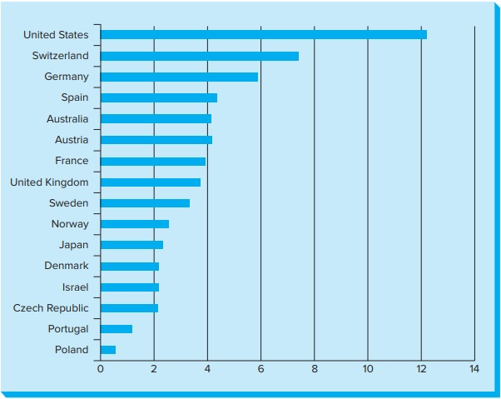
Relative Average Annual CEO Compensation in the United States and Selected Nations
Copyright © McGraw-Hill Education. Permission required for reproduction or display.
Figure 13.4
Access the text alternative for these images.

Slide 12
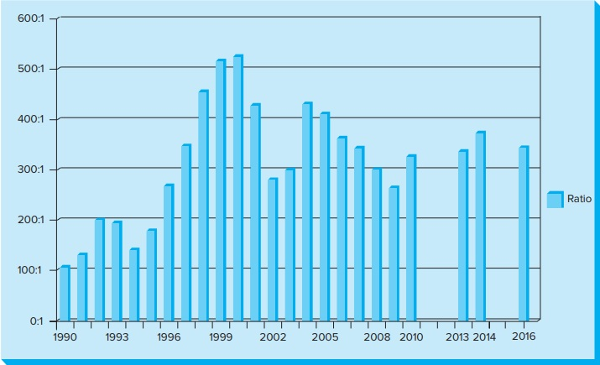
Ratio of Average CEO Pay to Average Production Worker Pay, 1990–2016
Copyright © McGraw-Hill Education. Permission required for reproduction or display.
Figure 13.5
Access the text alternative for these images.

Slide 13
Executive Compensation: Is it Justified?
Yes | No
Well-paid managers are simply being rewarded for outstanding performance. | Inflated executive pay hurts the ability of U.S. firms to compete with foreign rivals.
High salaries provide an incentive for innovation and risk-taking. | High executive pay causes mid- and lower-level employees to feel they are not receiving their fair share.
High compensation reflects a shortage of labor; necessary to attract top talent. Not many individuals are capable of running today’s large, complex organizations. | Empirical evidence finds weak relationship between executive pay and company success.

Slide 14

Government Rules on Executive Compensation
  Corporations must …
  Dodd-Frank Act require …
Notes:
Corporations must disclose top five executives’ compensation and the rationale for it.
Dodd-Frank Act require public companies to hold shareholder votes on executive compensation

Slide 15

Shareholder Activism
Rise of Institutional Investors
Social Investment
Stock screening
Social responsibility shareholder resolutions
Stockholder Lawsuits
Notes:
Rise of Institutional Investors
As shown earlier, holdings have increased significantly; have become more assertive in promoting interests of their members:
Have large blocks of stock not easy to sell if become dissatisfied.
Strong incentive to work to change management policy.
Council of Institutional Investors (CII):
Represents institutions and pension funds with investments collectively exceeding $3.5 trillion in holdings.
Developed a Shareholder Bill of Rights.
Research shows involvement of institutional investors can improve company performance.
Social Investment
Refers to the use of stock ownership as a strategy for promoting social, environmental, and governance objectives.
Can be done two ways:
Through selecting stocks according to various social criteria.
By using the corporate governance process to raise issues of concern.
Stock screening:
A growing number of mutual funds and pension funds use social screens to select companies in which to invest.
In 2016, $23 trillion of assets were managed using responsible investment strategies.
Socially responsible investing has rapidly grown in Europe, Latin America, and Asia.
Social criteria may also be used when selling stocks.
Social responsibility shareholder resolutions.
A resolution on an issue of corporate social responsibility placed before shareholders for a vote at the company’s annual meeting.
Significant rise in social responsibility shareholder resolutions in recent years – about 400 were sponsored in 2018.
Backers included faith-based institutions, individual shareholders, unions, environmental groups, universities, and etc.
The Securities and Exchange Commission (SEC) allows shareholders to place resolutions concerning appropriate social issues on the proxy ballot.
Resolutions can be about social issues, not company’s ordinary business.
In some cases, managers enter into a dialogue with shareholder activists and resolve an issue before the election.
Stockholder Lawsuits
If owners think they or their company have been damaged by actions of company officers or directors, they have a right to bring lawsuits.
Shareholder lawsuits maybe initiated to check abuses.
Examples:
Insider trading.
Inadequate stock buyout price.
Timely disclosure of material information.
The outcome can be very expensive for companies.

Slide 16

Securities and Exchange Commission (SEC)
The major government agency responsible for protecting shareholders’ interests:
Unlike many government agencies, generates revenue to pay for itself.
Information Transparency and Disclosure
Insider trading
Notes:
The major government agency responsible for protecting shareholders’ interests:
Mission: to make sure that stock markets are run fairly.
Needed because shareholders can be hurt by abuses, such as false information and insider trading.
Unlike many government agencies, generates revenue to pay for itself.
Information Transparency and Disclosure
Companies are required to issue truthful annual financial reports.
Many companies have begun reporting detailed information about social and environmental, as well as financial, performance.
Insider trading:
Occurs when a person gains access to confidential information about a company’s financial condition.
Uses that information, before it becomes public knowledge, to buy or sell the company’s stock for a profit.
It is against the law to:
Steal nonpublic information and use it to trade a stock.
Trade a stock based on a tip from someone who had an obligation to keep quiet.
Pass information to others with an expectation of gain.

Slide 17
Shareholders and the Corporation
Shareholders have become an increasingly powerful and vocal stakeholder group in corporations.
Shareholders do more than just provide capital
Notes:
Shareholders have become an increasingly powerful and vocal stakeholder group in corporations.
Provide capital.
Monitor corporate performance.
Assure the effective operation of stock markets.
Bring new issues to the attention of management.
Play a very important role in making the business system work.

Slide 18
End of Main Content
Notes:
Closing slide.

Slide 19
Accessibility Content:
Text Alternatives for Images

Slide 20
Stock Market Capitalization as a Percentage of GDP, 2016
Text Alternative
The x-axis contains six markings. From the left to the right, these markings read 0, 50, 100, 150, 200, and 250.
The y-axis contains nine countries. From the bottom to the top, these countries read Indonesia, Russian Federation, Brazil, India, Australia, Japan, Korea, China, and the United States.
Bars extend from the y-axis parallel to the x-axis and represent the total value of stocks in that nation as a percentage of their gross domestic product.
From the bottom to the top, the data reads as follows:
Stock market capitalization for Indonesia is approximately 7 percent of its GDP.
Stock market capitalization for the Russian Federation is approximately 8 percent of its GDP.
Stock market capitalization for Brazil is approximately 30 percent of its GDP.
Stock market capitalization for India is approximately 40 percent of its GDP.
Stock market capitalization for Australia is approximately 70 percent of its GDP.
Stock market capitalization for Japan is approximately 110 percent of its GDP.
Stock market capitalization for Korea is approximately 115 percent of its GDP.
Stock market capitalization for China is approximately 170 percent of its GDP.
Stock market capitalization for the United States is approximately 260 percent of its GDP.
Return to slide containing original image.

Slide 21
Household Versus Institutional Ownership in the United States Text Alternative
The x-axis is labeled year. There are eight markings on the x-axis. From the left to the right, these markings read 1965, 1975, 1985, 1995, 2000, 2005, 2010, and 2016. Below the markings on the x-axis, there is content that reads total market value.
In the year 1965, the total market value was 735 billion dollars.
In the year 1975, the total market value was 839 billion dollars.
In the year 1985, the total market value was 2,270 billion dollars.
In the year 1995, the total market value was 8,481 billion dollars.
In the year 2000, the total market value was 17,627 billion dollars.
In the year 2005, the total market value was 18,512 billion dollars.
In the year 2010, the total market value was 23,293 billion dollars.
In the year 2016 the market value was 38,685.
The y-axis contains ten markings. From the bottom to the top, these markings read 0, 10, 20, 30, 40, 50, 60, 70, 80, and 90.
Two vertical bars arise from each year. A key indicates that the darker bars represent households and lighter bars represent institutions.
In the year 1965, household ownership in the United States was approximately 82 and institutional ownership was approximately 15.
In the year 1975, household ownership in the United States was approximately 69 and institutional ownership was approximately 29.
In the year 1985, household ownership in the United States was approximately 52 and institutional ownership was approximately 45.
In the year 1995, household ownership in the United States was approximately 50 and institutional ownership was approximately 48.
In the year 2000, household ownership in the United States was approximately 45 and institutional ownership was approximately 52.
In the year 2005, household ownership in the United States was approximately 30 and institutional ownership was approximately 68. I
n the year 2010, household ownership in the United States was approximately 35 and institutional ownership was approximately 60.
In the year 2016, household ownership was just over 40 and institutional ownership was just under 60.
Return to slide containing original image.

Slide 22
Relative Average Annual CEO Compensation in the United States and Selected Nations Text Alternative
The x-axis contains eight markings. From the left to the right, these markings read 0, 2, 4, 6, 8, 10, 12, and 14.
The y-axis contains sixteen markings. From the bottom to the top, these markings read Poland, Portugal, Austria, Czech Republic, Japan, Norway, Sweden, Netherlands, United Kingdom, France, Australia, Spain, Germany, Switzerland, Canada, and United states.
Bars extend to the right from the y-axis, and are parallel to the x-axis.
From bottom to top, the data reads as follows:
Poland about a half million dollars.
Portugal around 125 million dollars.
Czech Republic around 2.3 million dollars.
Israel around 2.3 million dollars.
Denmark about 2.3 million dollars.
Japan around 2.3 million dollars.
Norway around 2.5 million dollars.
Sweden near 3.4 million dollars.
United Kingdom around 3.75 million dollars.
France just under 4 million dollars.
Austria around 4.3 million dollars.
Australia around 4.3 million dollars.
Spain about 4.25 million dollars.
Germany around 5.8 million dollars.
Switzerland about 7.5 million dollars.
United States just over 12.2 million dollars.
Return to slide containing original image.

Slide 23
Ratio of Average CEO Pay to Average Production Worker Pay, 1990–2016 Text Alternative
The x-axis contains eleven markings. From the left to the right, these markings read 1990, 1993, 1996, 1999, 2002, 2005, 2008, 2010, 2013, 2014, and 2016. The y-axis contains ratio indicators from the bottom to top reading 0:1; 100:1; 200:1; 300:1; 400:1; 500:1; and 600:1.
Bars extend upward from the x-axis, and are parallel to the y-axis.
From left to right the ratio per year reads as follows:
In the year 1990, approximately 100:1.
In the year 1993, approximately 200:1.
In the year 1996, approximately 270:1.
In the year 1999, approximately 510:1.
In the year 2002, approximately 280:1.
In the year 2005, approximately 410:1.
In the year 2008, almost exactly 300:1.
In the year 2010, approximately 330:1.
In the year 2013, approximately 335:1.
In the year 2014, approximately 380:1.
In the year 2016, approximately 350:1.
It is notable that the ratio increases during times of economic growth (late 1990s boom), and decreases during periods of economic contraction (Great Recession of 20008-2009).
Return to slide containing original image.

